Slide 1

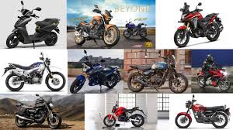
SQL PROJECT
BIKE STORE
BIKE STORE ANALYSIS

Slide 2
OVERVIEW:
BIKE STORE mission is to build relationships, empower others, and strengthen the community through Bikes.
Bike Store’s purpose is to achieve maximum Sales from Customers at different locations of city in different State’s by selling number of units classified under product name, brand name and category name
Bike Store works hard to achieve it’s targeted revenues

Slide 3
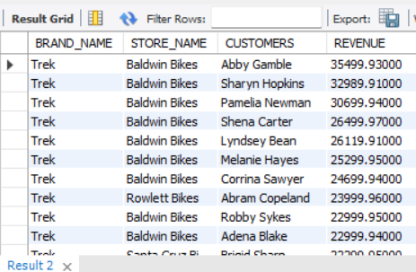
QUESTION NO.1
Find Total Top 20 Revenue earned by each customer grouped by brand and store name and order them from largest to smallest

Slide 4
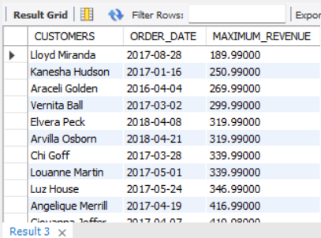
QUESTION NO.2
Find maximum revenue for unique customers where state in CA (Califonia) with respect to order date

Slide 5
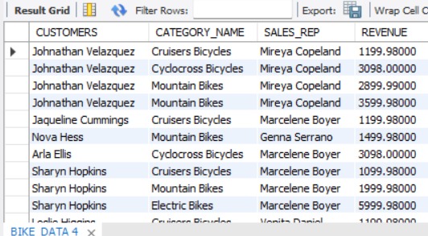
QUESTION NO.3
Find Unique Customers whose revenue falls between 1000 to 8000 with respect to category and sales representative

Slide 6
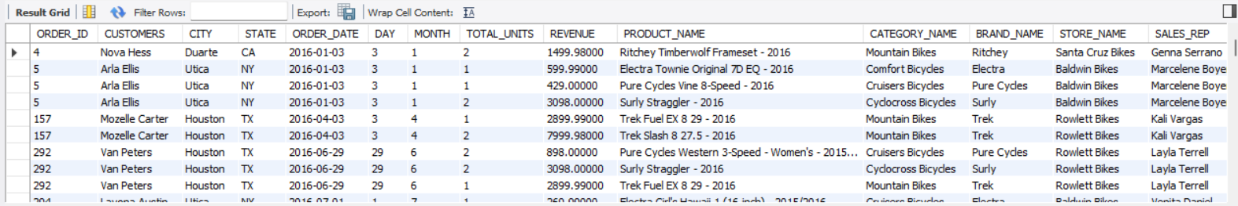
Question No. 4
Find records where city is utica, duarte and Houston

Slide 7

QUESTION NO. 5
Which is the most common product name based on maximum revenue?

Slide 8
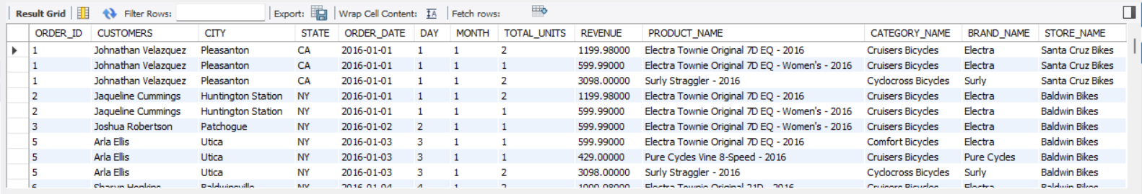
QUESTION NO. 6
Find Category where name starts with 'C' and ends with 'S' for all records

Slide 9
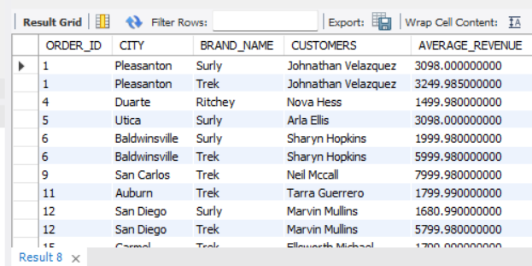
QUESTION NO. 7
Find revenue for customers where average revenue is greater than 1000 with respect to City, Brand Name and Order ID

Slide 10
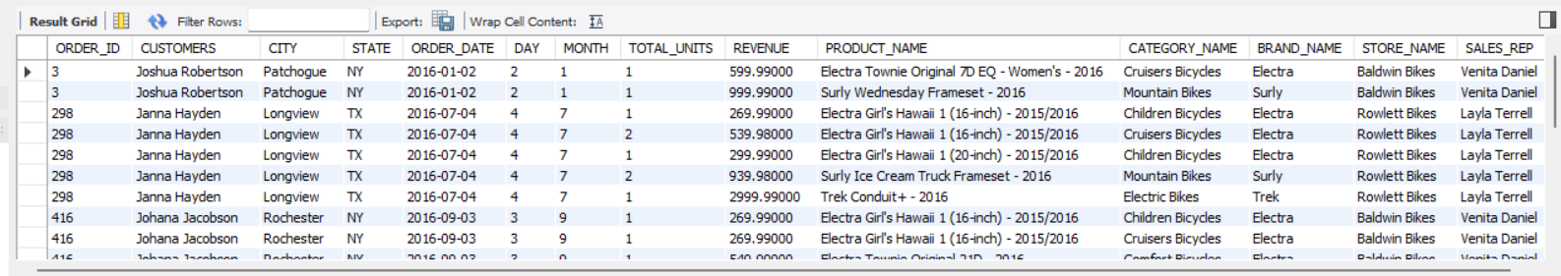
QUESTION NO. 8
Find records where name of Customer starts with 'j' and in between alphabet is 'h' and last alphabet is 'n'

Slide 11
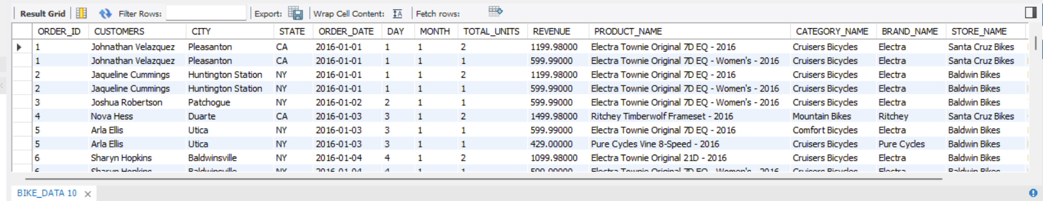
QUESTION NO. 9
Find all records where brand name is not surly and trek

Slide 12
QUESTION NO.10
Find records from Bike Store where revenue is equal to minimum of revenue

Slide 13
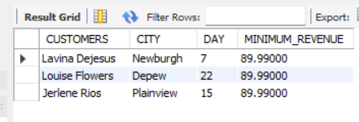
QUESTION NO.11
Which particular day has the customer earned the minimum revenue?

Slide 14
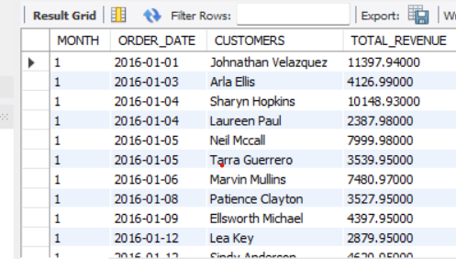
QUESTION NO. 12
Which month has total revenue more than 2000 with respect to customer and order date?

Slide 15
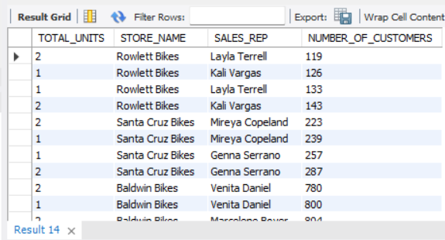
QUESTION NO.13
Find unique units when grouped by store name and sales representative for all number of customers

Slide 16
SUMMARY
Found actionable insights that contribute to BIKE STORE strategy for Business Decisions. This project offers a straightforward path for success and helps in solid decision-making strategy.

Slide 17
THANK YOU
JAIMIN SHAH

